Slide 1
The Toll Reality in Central Texas
Steve Pustelnyk
Director of Communication
May 26 , 2011

Slide 2
A Little History

Slide 3
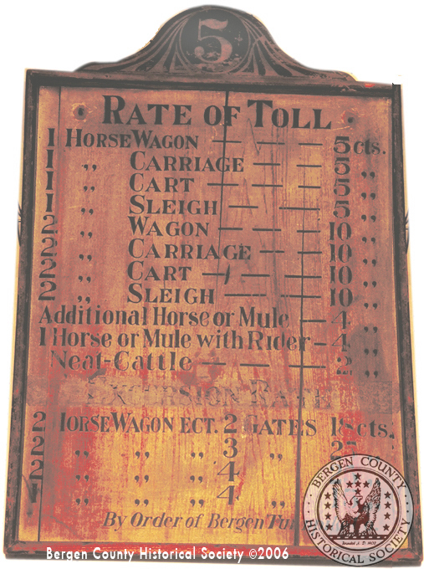
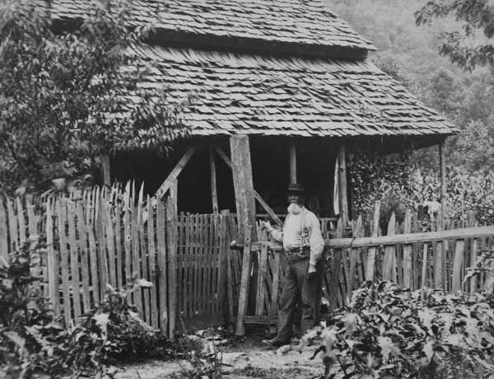
A Little History
Toll roads were an integral part of our country’s development
  Wilderness Path: 209-mile toll road built across Kentucky in 1775
  Lancaster Pike: 62-mile hard surface toll road between Philadelphia and Lancaster Pennsylvania opened in 1794

Slide 4
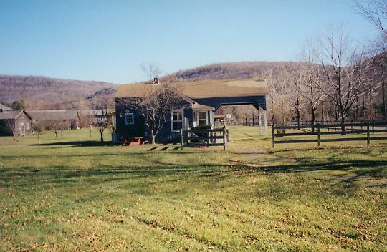
A Little History
By the early 1800’s there were more than 175 private companies operating 3,000 miles of toll roads in the United States

Slide 5
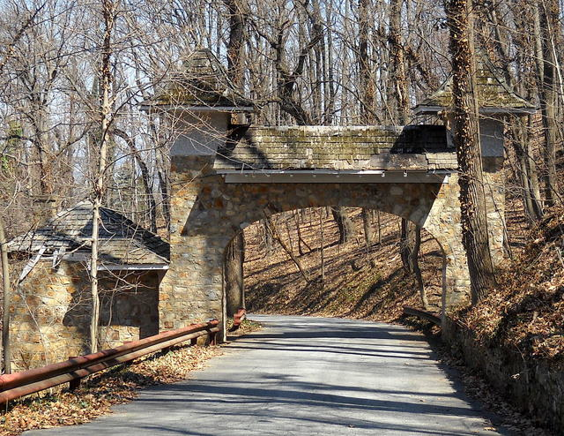
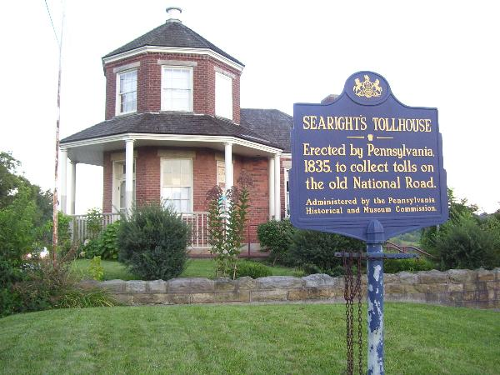
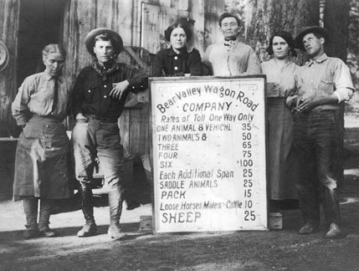
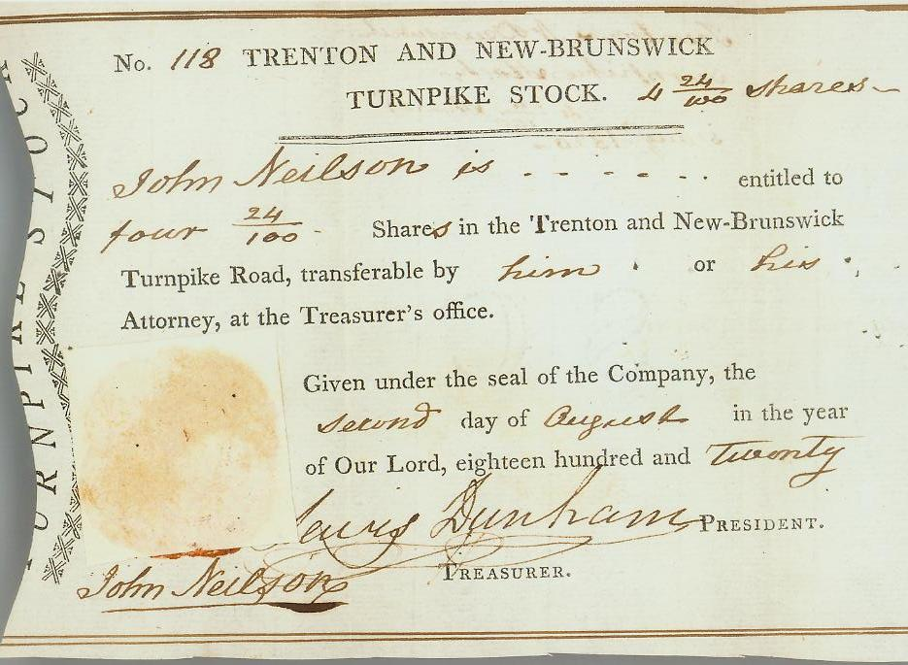

Slide 6
A Little History
First modern highways in the United States were state developed toll roads
  Merritt Parkway (1938)
  Pennsylvania Turnpike (1940)
President Roosevelt originally proposed a modern limited-access interstate highway system funded through tolls
Federal Bureau of Public Roads preferred a tax based funding approach
In 1956 the debate was settled with the gas tax funded interstate highway system

Slide 7
The Post Interstate Era

Slide 8
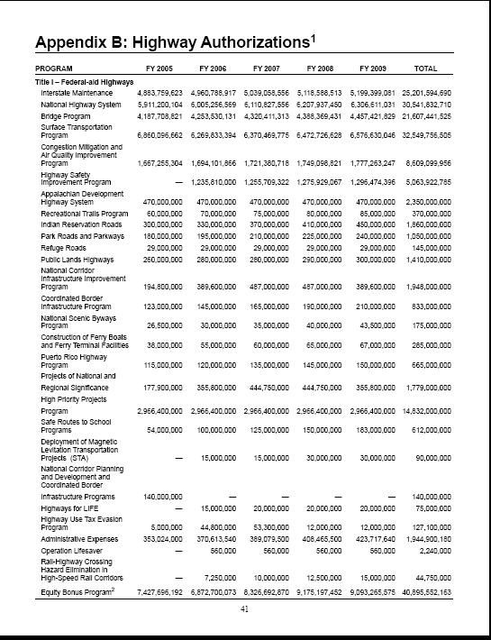
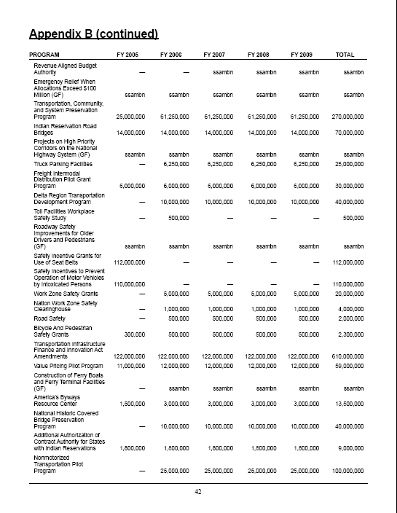
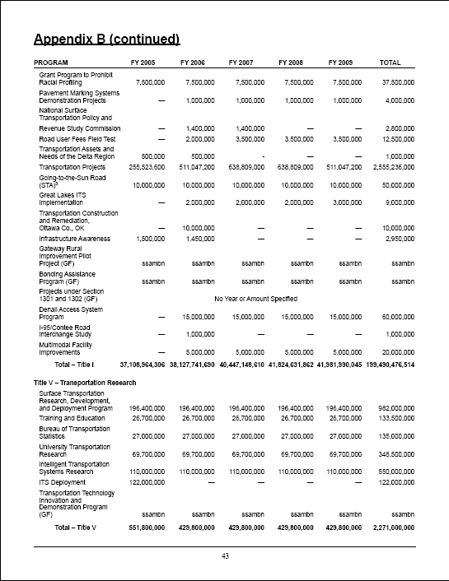
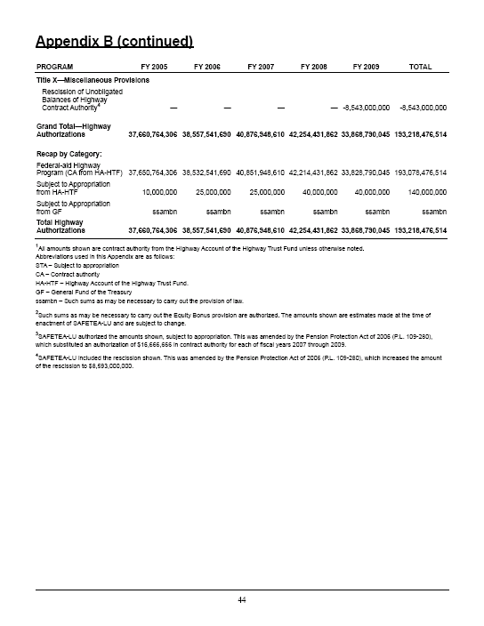
The Post Interstate Era
Transition from construction to maintenance
  46,876 miles of interstate
Increasing diversion of funds to special interests
Anti-toll mentality
  Bi-partisan
No National Transportation Policy Leadership!

Slide 9
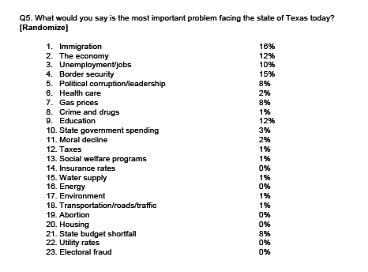
Transportation is Not a High Priority!
University of Texas/Texas Tribune Poll conducted May 11-17, 2011

Slide 10
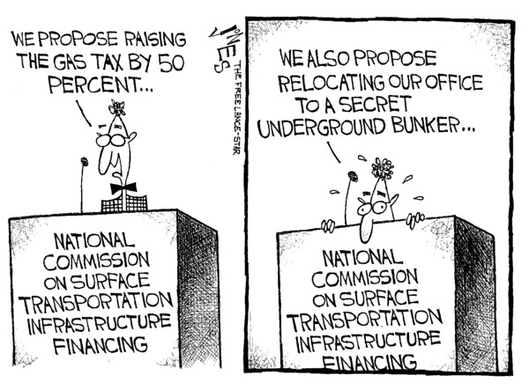

Slide 11
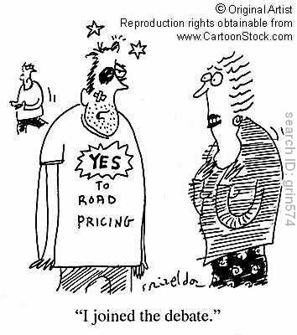
What’s the Alternative?
No one knows….
  Build toll lanes 27%
  Increase sales tax 16%
  Increase vehicle registration fees 21%
  Increase the gasoline tax 6%
  Other 16%
  Undecided/Refused 15%
Alamo Regional Mobility Authority Survey, Baselice and Associates, September 2005

Slide 12
What can we do?
Develop new strategic vision for transportation
Adopt sustainable financing and operational mechanisms that serve public policy goals
  Expansion of user fees
  Per mile charging
  Congestion pricing
  Increased private investment
  Market based pricing of transportation
  Cost/benefit analyses
  Increase links between land use planning and transportation
Empower local communities

Slide 13
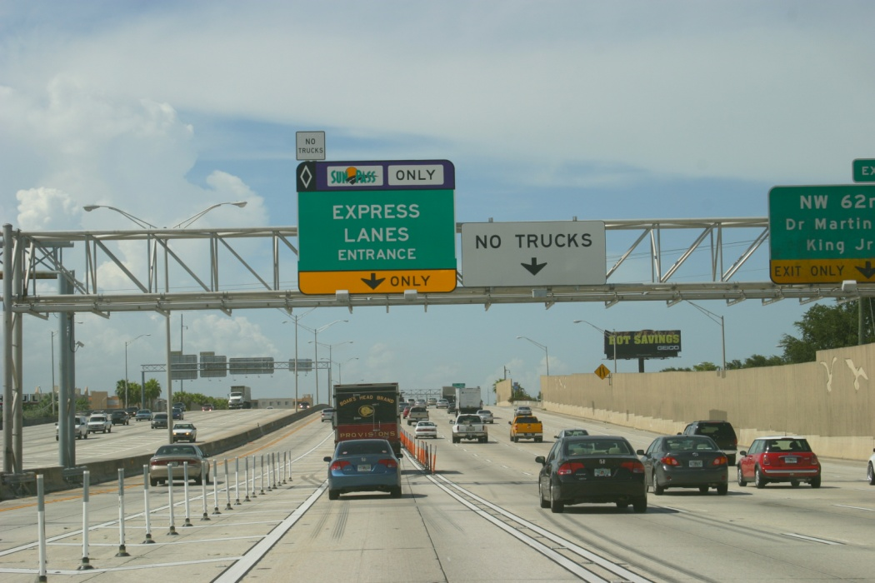
What’s Being Done?
Some innovative ideas being tried across the United States
  New York City Cordon Pricing
  Indiana Tollway Concession
  Washington Beltway/I-95 Concession
  San Diego South Bay Expressway Concession
  Maryland Inter-County Connector
  Miami I-95 Express Lanes
  North Carolina Turnpike Authority

Slide 14
Texas at the Forefront

Slide 15
Texas at the Forefront
Emphasis on tolling
Public Private Partnership projects
Congestion Pricing/Express Lanes
Push for greater local control and responsibility
    Metropolitan Planning Organizations
    Regional Mobility Authorities
      New toll projects open in Tyler and Brownsville
      Projects under development in El Paso and San Antonio
After a period of political unrest Central Texas has accepted the Toll Reality and is on the move!

Slide 16
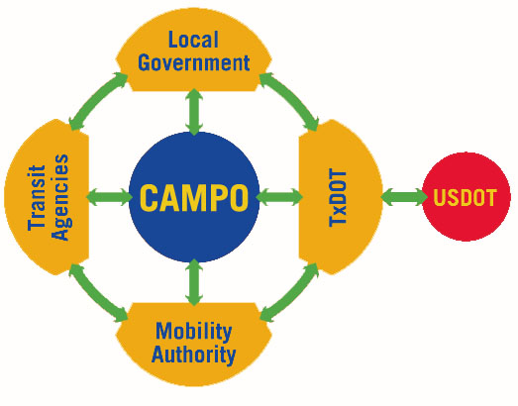
Emphasizing Local Control

Slide 17
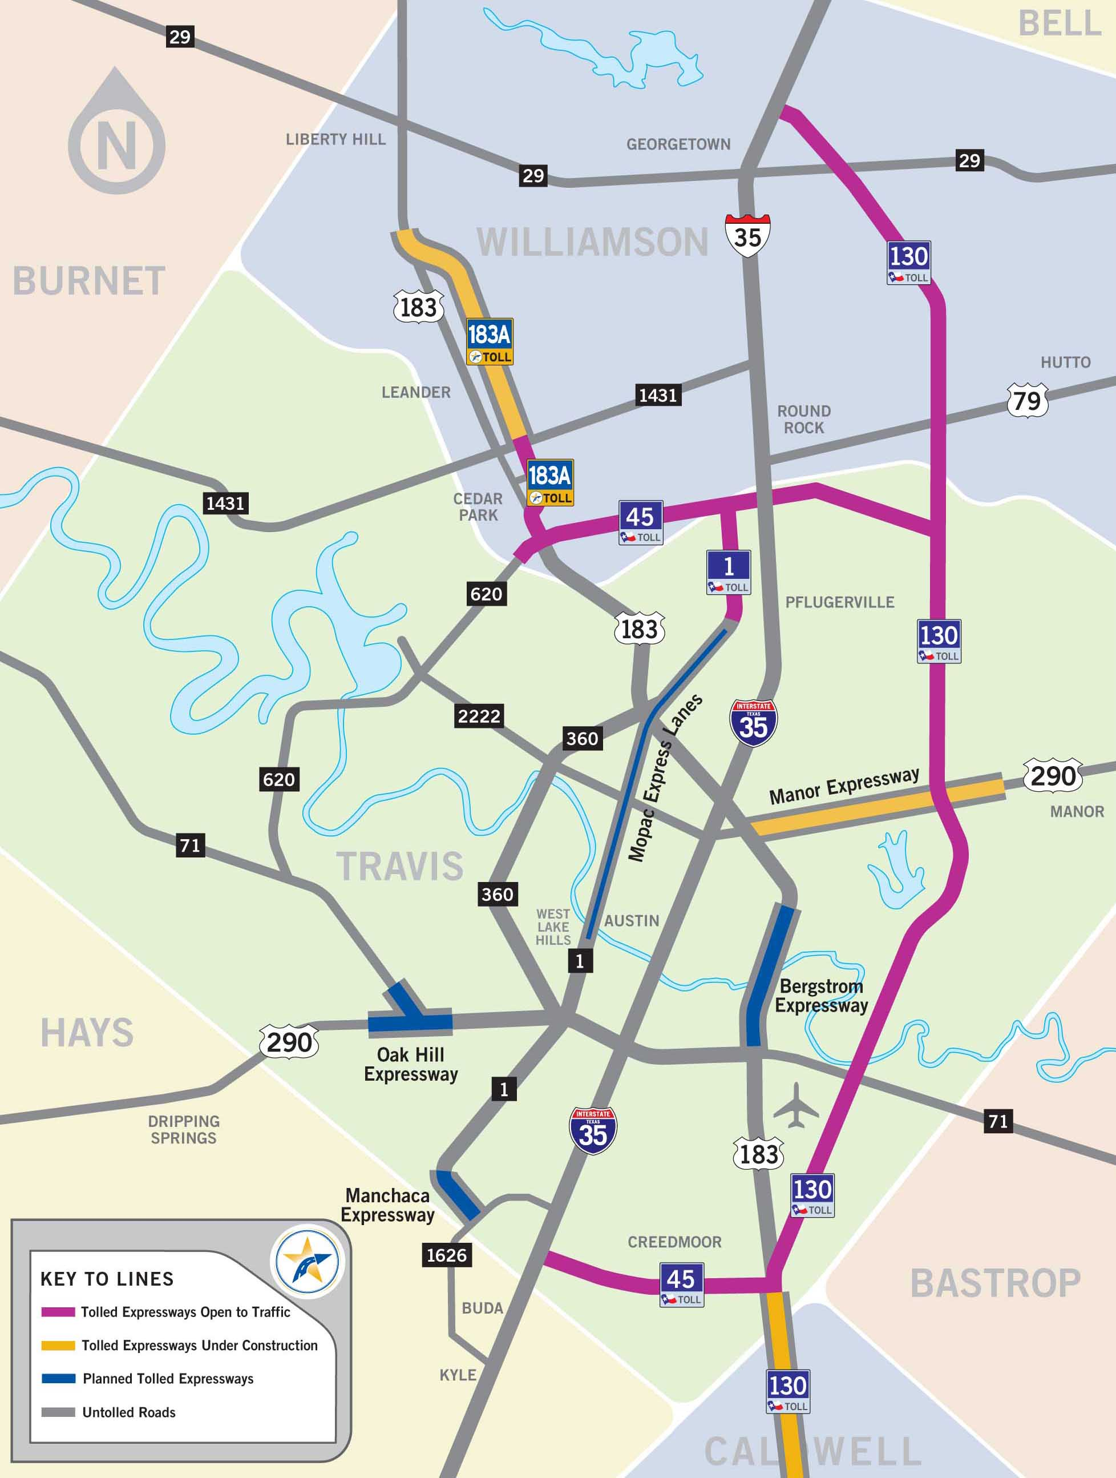
Regional Expressway Plan
More than $4 billion in new roadway capacity in just the last five years
Another $1 billion plus expected over the next five years

Slide 18
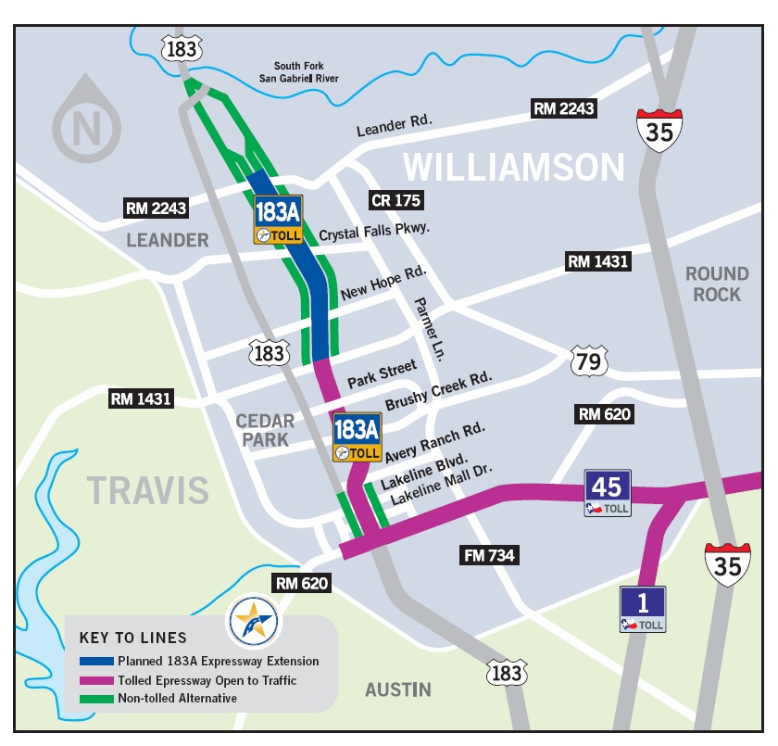
Our First Project: 183A Expressway
11.6 miles
$238 million
Opened March 2007
Built using Comprehensive Development Agreement
  Design/Build

Slide 19
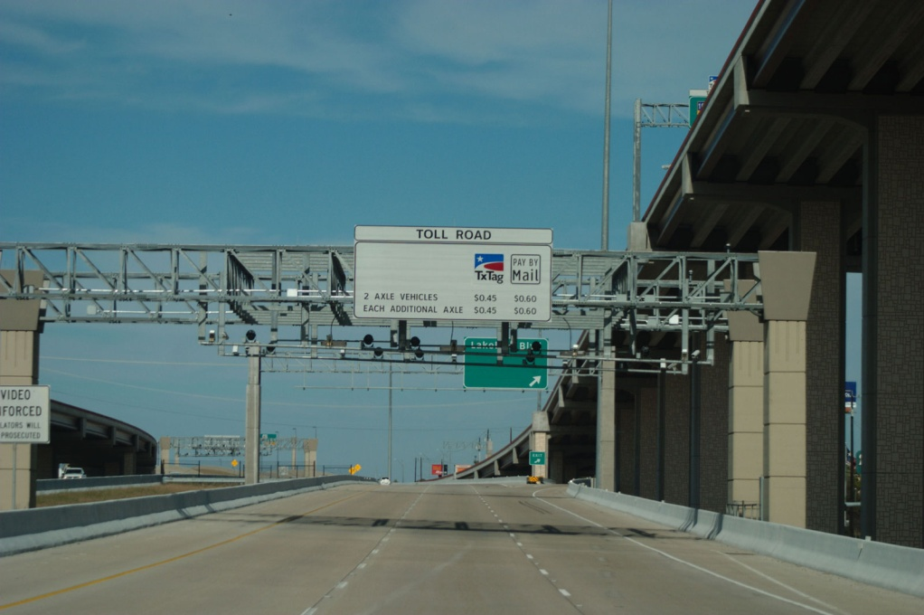
183A Performance
In first year transactions were 102% higher than projected
Nearly 80% toll tag penetration
  Original projection assumed 52% toll tag penetration by 2010
Cashless All-Electronic Toll Collection implemented in December 2008

Slide 20
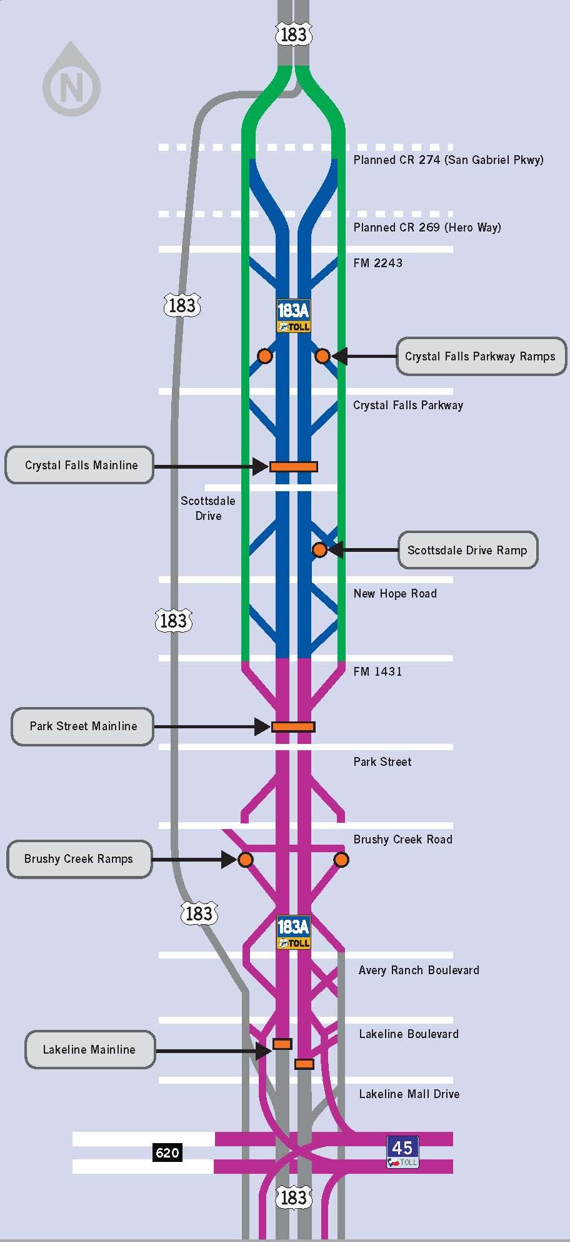
183A Northern Extension
5-mile limited-access expressway with three tolled lanes and non-tolled frontage
Constructed in the median of the existing frontage roads from FM 1431 to north of RM 2243
Cost: $105 million
Opening 2012

Slide 21
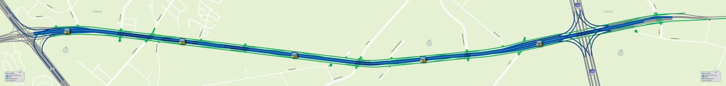
Manor Expressway
Ultimate project
  6.2 mile six lane toll facility, extending from US 183 to Parmer Lane
Interchange at US 183 under construction
    Funded through federal stimulus program
Total Project Cost: $ 400 million (+/-)
Comprehensive Development Agreement completed
Financing scheduled for June 2011
Construction pending
  Interim completion 2012
  Final completion 2014

Slide 22
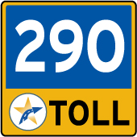
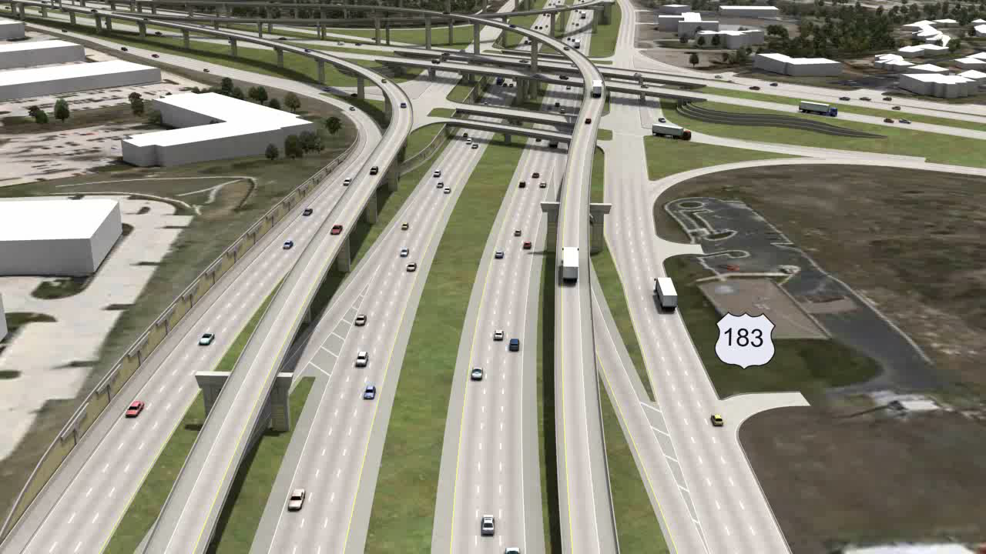
Manor Expressway

Slide 23

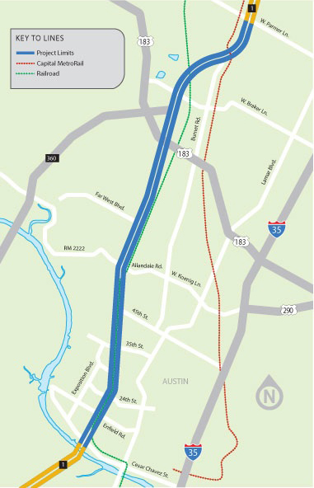
MoPac Improvement Project
Environmental study underway
Express Lane alternative being studied
  Congestion management
  Enhanced Express Bus service
  Source of funding
Construction 2013
Beginning of regional express lanes network?

Slide 24
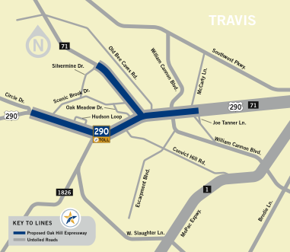
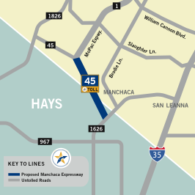
Upcoming Projects
Bergstrom Expressway (US 183)
  Environmental clearance 2012
  Construction 2015
  Possible Public Private Partnership
Oak Hill Expressway (US 290/SH71)
  Environmental study 2011
Manchaca Expressway (SH 45)
  Environmental study 2011

Slide 25

Overview
Two part judging process:
  8 to 10 member expert technical panel to review all submittals and shortlist top 3 teams for each project
  12 to 15 member prominent industry and community leaders panel view presentations from top teams to determine overall winners
    Presentations open to the public
Submittals will be evaluated with the following criteria:
  Sustainable impact
  Concept quality design
  Cost effectiveness
  Innovation

Slide 26
Timeline
Date (2011)* | Design Competition Activity
July 1 | Launch Competition and Open Registration
October 3 | Team Submittals Due
October 27 | Finalists Announced
November 17 | Presentations and Awards Ceremony
*Tentative

Slide 27
Conclusion
Over the past 200 years we have evolved:
  from a privately funded user fee driven local road system to a national tax based roadway network
We are about to enter a completely new era:
  one that will use past experience combined with new ideas and advanced technologies to revolutionize the way we move people
Central Texas is leading the way!

Slide 28
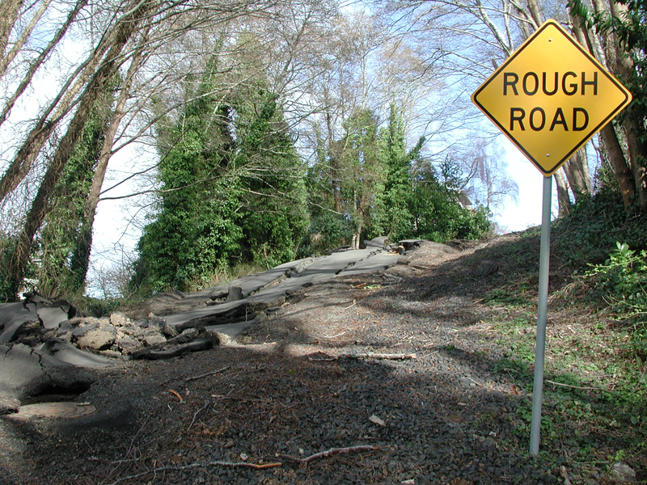
It’s a rough road ahead……

Slide 29
For More Information
Steve Pustelnyk
Director of Communications
www.mobilityauthority.com
512.996.9778

