Slide 1
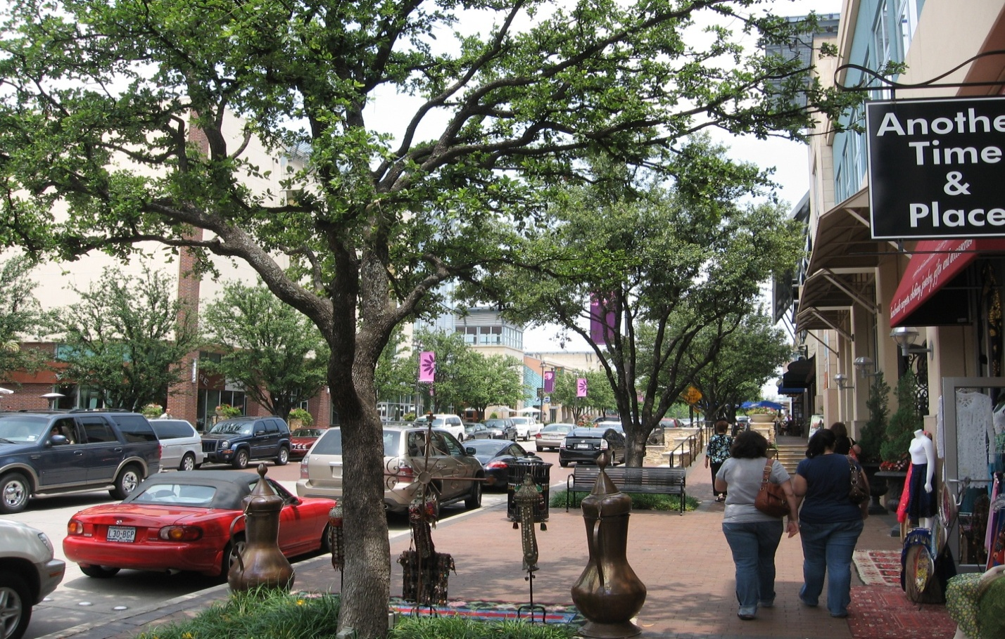
Context Sensitive Solutions
For Designing
Urban Thoroughfares
Brian Bochner
Senior Research Engineer
Texas Transportation Institute

Slide 2
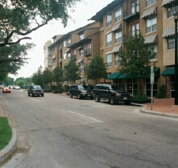
Communities Want:
Flexibility
Compatibility with adjacent land uses
Balanced land use/transportation functions
Safe and attractive streets
Multimodal facilities
Quality public street space
Agencies Typically Start To:
Improve mobility
Improve safety
Meet environmental requirements
Pursue low maintenance
Spend cost-effectively
Notes:
2nd and 4th bullet are pretty much the same
Add safety!

Slide 3

CSS Defined
CSS is
Collaborative
Interdisciplinary
Involves all stakeholders
Resulting facility
  Fits its physical setting
  Preserves scenic, aesthetic, historic, and environmental resources
  Maintains safety and mobility

Slide 4
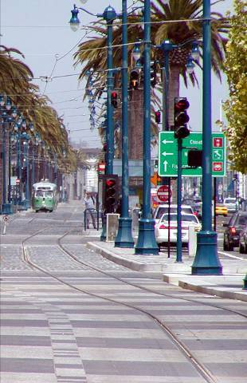
Tenets of CSS
Balance
  Safety
  Mobility
  Community objectives
  Environment
Multimodal
Involve public, stakeholders
Interdisciplinary teams
Flexibility in design
Incorporate aesthetics
Source: Minnesota Department of Transportation

Slide 5
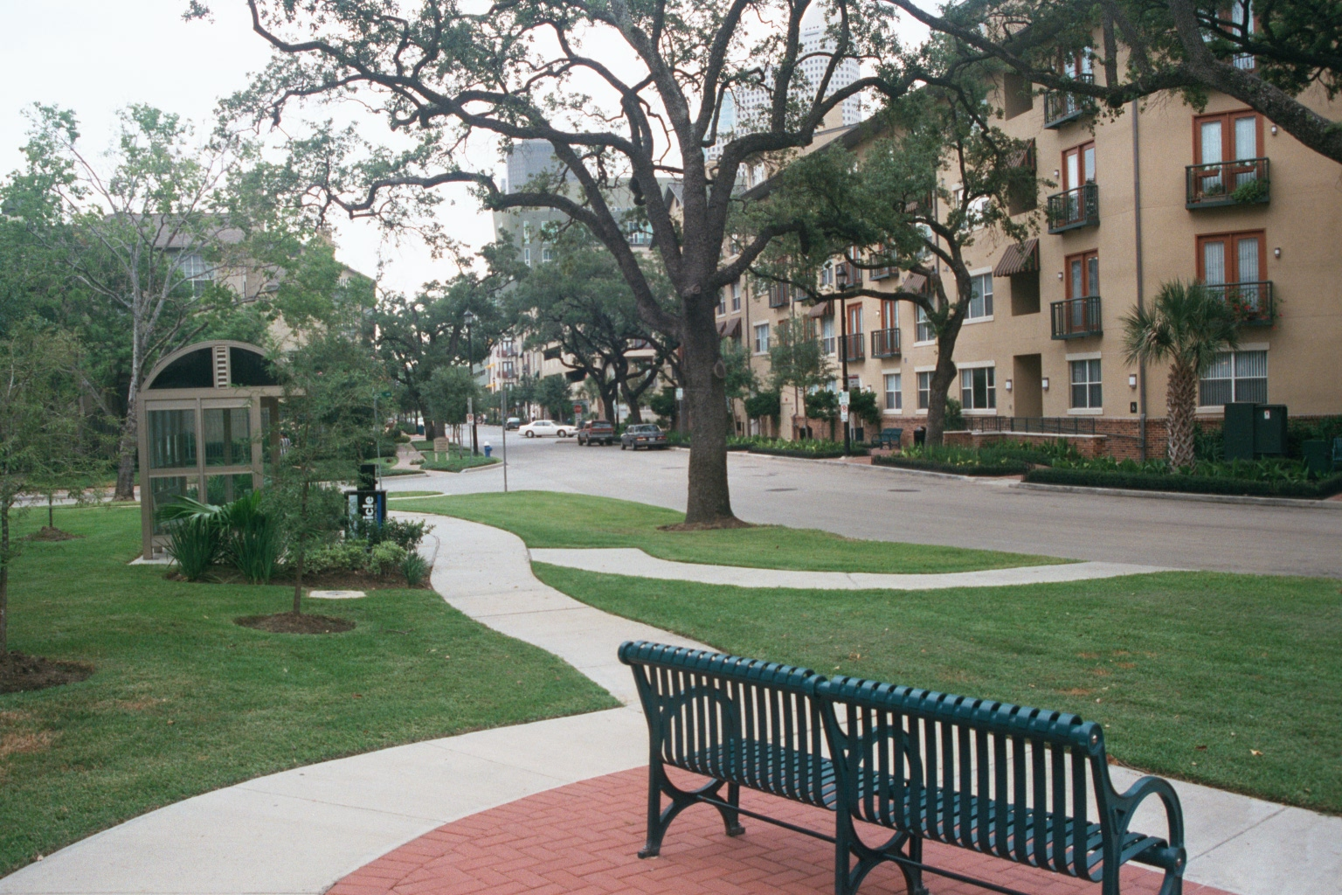
Context Integration
Baldwin Street, Houston

Slide 6
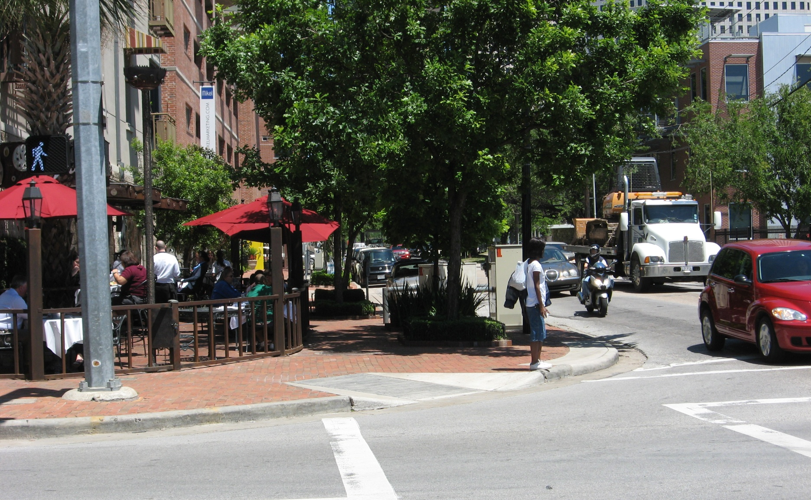
Context Integration
Gray and Bagby Streets, Houston

Slide 7
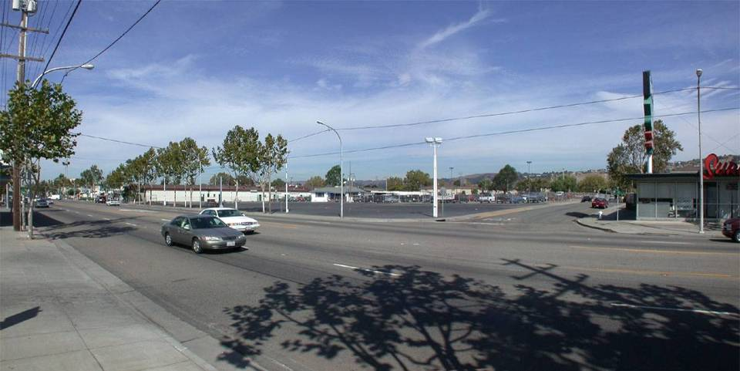
CSS: Bringing Place and Thoroughfare Design Together
E14th Corridor - San Leandro, CA Source: Community, Design + Architecture

Slide 8
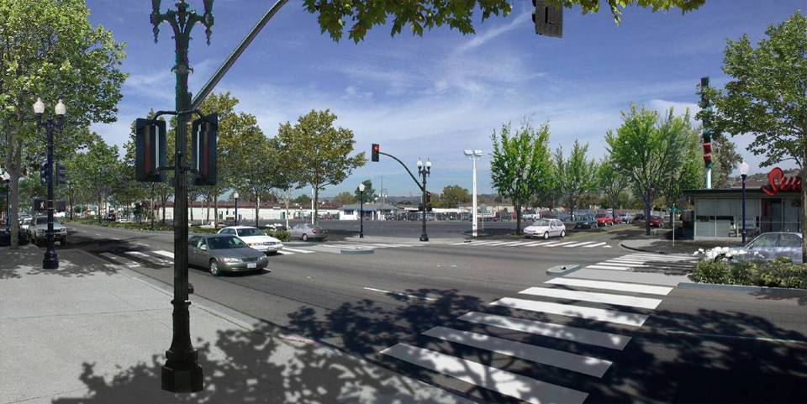
CSS: Bringing Place and Thoroughfare Design Together
E14th Corridor - San Leandro, CA Source: Community, Design + Architecture

Slide 9
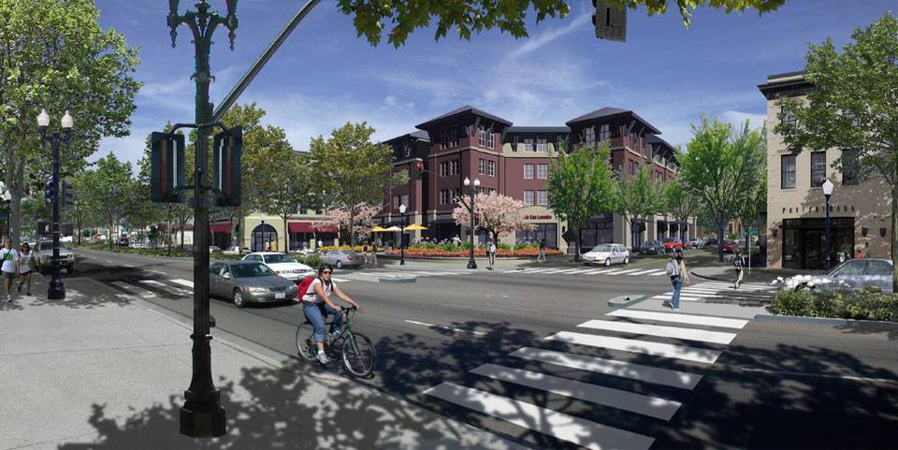
CSS: Bringing Place and Thoroughfare Design Together
E14th Corridor - San Leandro, CA Source: Community, Design + Architecture

Slide 10
Challenges
Safety
Physical Character
Cost
Multimodal
Considerations
Project
Design
Environmental Quality
Historical and Scenic Characteristics
Accessibility
Capacity
Natural & Human Environment

Slide 11
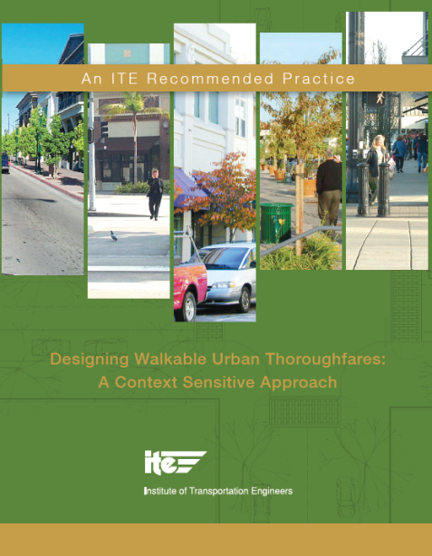
CSS (Federal) Milestones
1997 – FHWA Flexibility in Highway Design
1998 – “Thinking Beyond the Pavement” workshop
2003 – CSS included in FHWA performance plan
2005 – CSS promoted in SAFETEA-LU
2006 – ITE/CNU/FHWA/EPA CSS in Designing Major Urban Thoroughfares for Walkable Communities
2009 – TxDOT adopts ITE CSS report into project development process ITE/CNU/FHWA/EPA manual
2010 – ITE/CNU/FHWA/EPA Designing Walkable Urban Thoroughfares: A Context Sensitive Approach

Slide 12


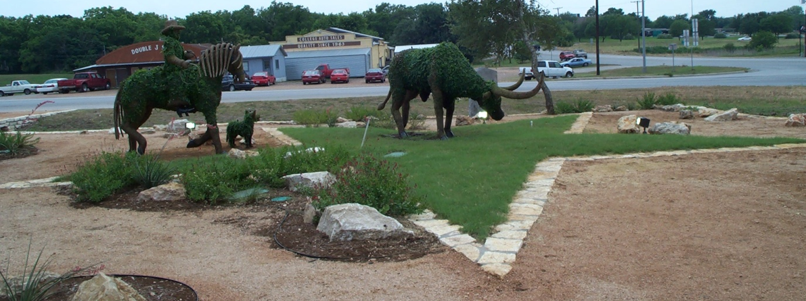
What is CSS?
More than mitigation . . .
More than public meetings…
More than enhancements . . .
More than a fad . . .
Michigan DOT

Slide 13
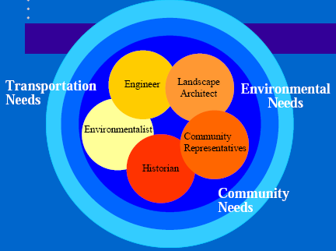
What is CSS?
Process
Shared vision
Collaboration
Comprehensive understanding of contexts
Flexibility and creativity to fit conditions
Interdisciplinary
Coordinated multimodal transportation and land use decisions

Slide 14
Why Use CSS?
This
Listen
Design
Build
Decide
Design
Defend
Not this
Re-Design
Delay

Slide 15
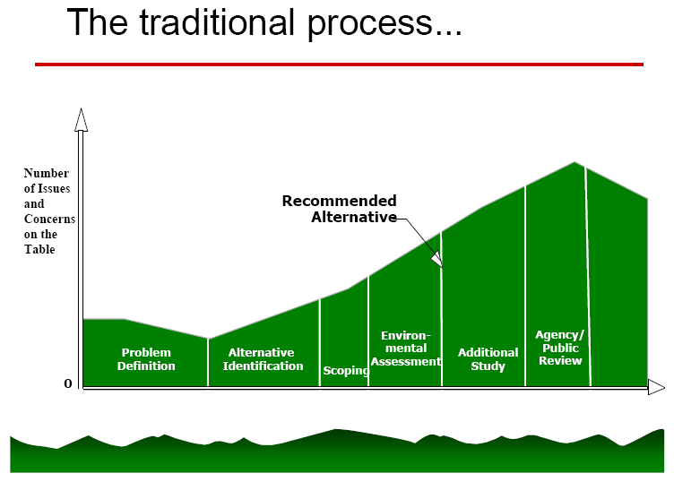
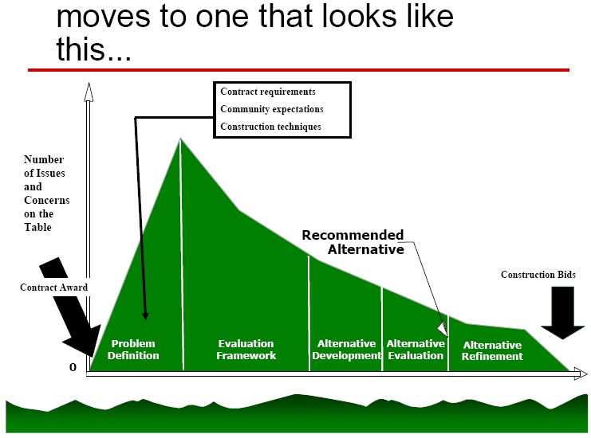
CSS Benefit

Slide 16
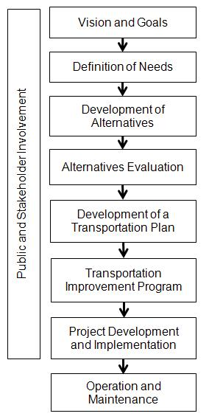
CSS Start to Plan and Design
Vision and Goals
Long-range vision
Community values and issues
Community and agency priorities
Educate stakeholders on issues, process and constraints
Establish planning process

Slide 17
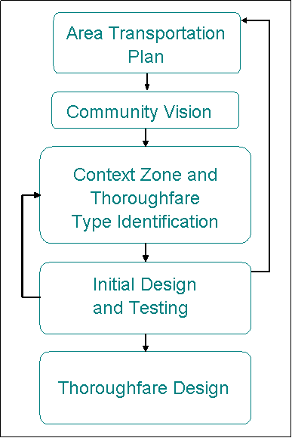
CSS Design Process
Area Plan
Vision
Compatibility
Initial concept/testing
Design

Slide 18
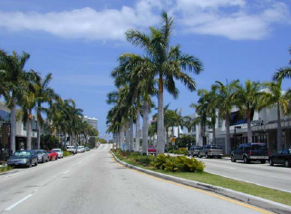
CSS Design Framework
Functional classification
Context zones:
  Suburbs - downtowns
Street classification:
  Thoroughfare type
Compatibility & mutual support

Slide 19
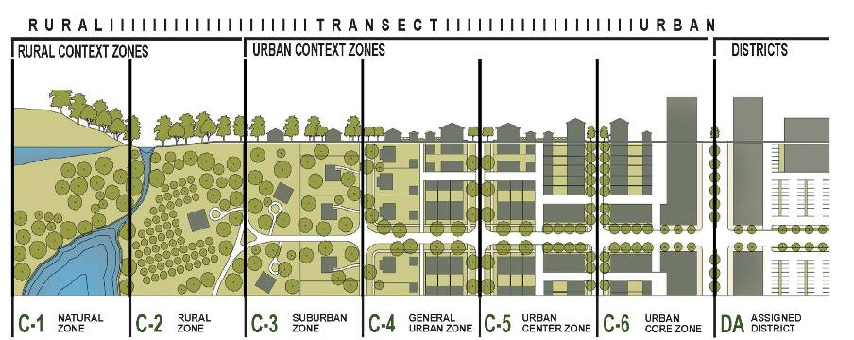
Context Zones – An Organizing System for Thoroughfare Design
Source: Duany Plater-Zyberk and Company
Notes:
The context zones are based on DPZ’s transect zones which divides the continuum of land uses from natural/agricultural environments to urban cores and special districts.
The CZ’s, like the transect, is a structure for organizing urban form and urban design elements.

Slide 20
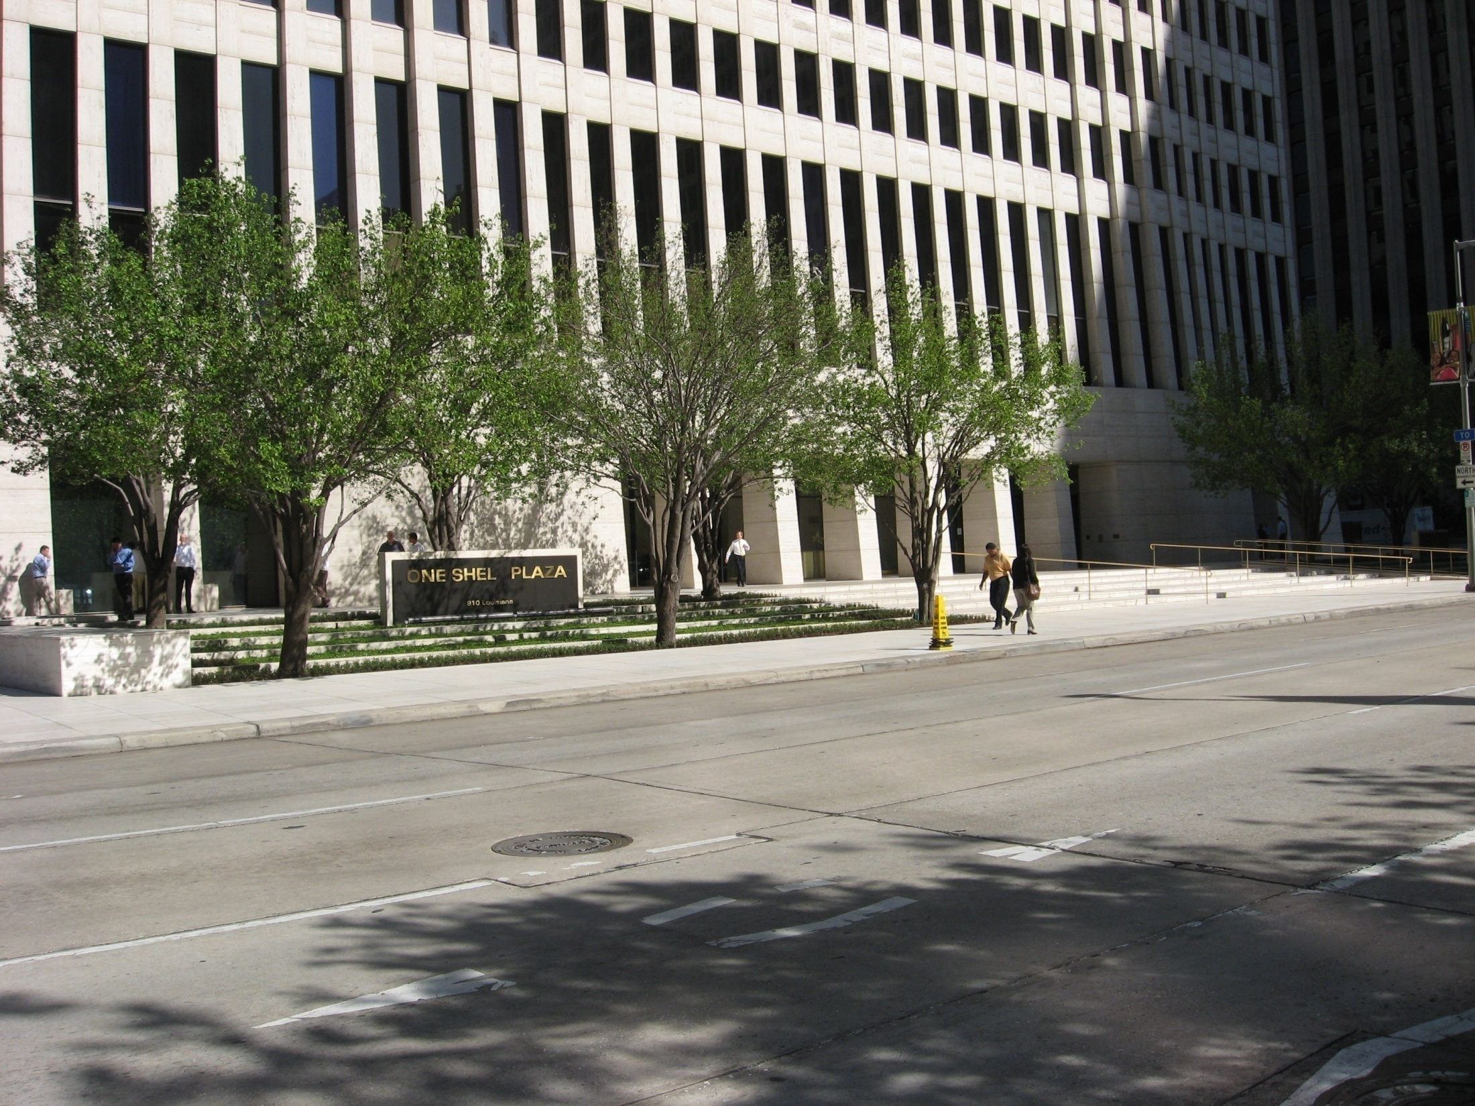
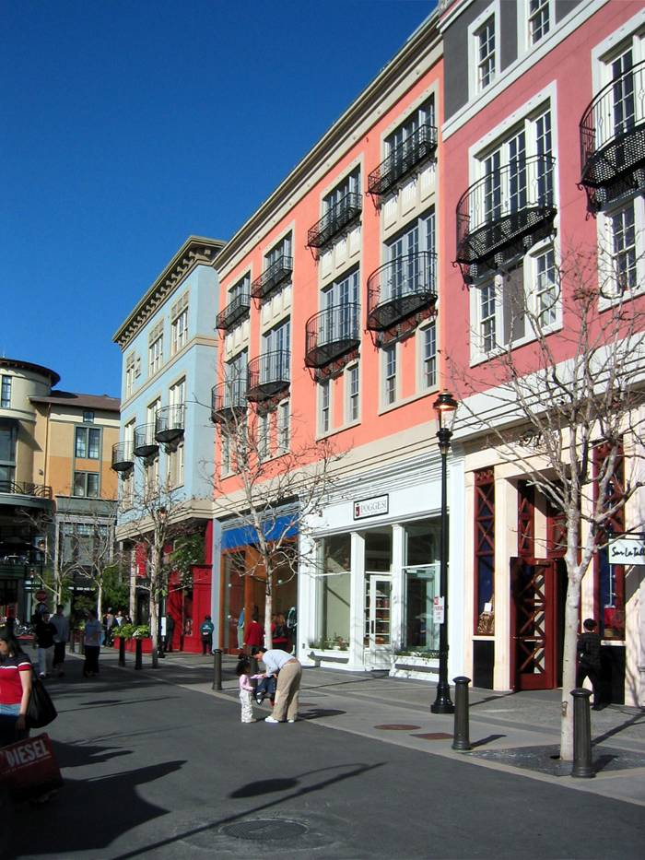
Features That Create Context
Land use
Activities
Site design
Building design
Landscape design
Natural features
Character of public space
Notes:
Add landscape design, natural features, and character of public space

Slide 21
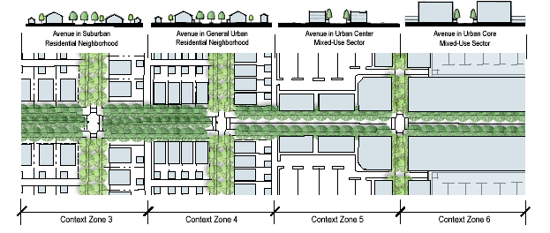
CSS Tenet –Thoroughfare Design Changes as Context Changes
“Thoroughfare design is not just sensitive to context—but part of the context and helps define the place”

Slide 22
CSS vs. Conventional Thoroughfare Design Approach
Conventional | CSS Approach
Context: Urban Rural | Context: Suburban General urban Urban Center Urban Core
Design criteria primarily based on: Functional class Design speed Travel demand Level of service | Design criteria primarily based on: Community objectives Functional class Thoroughfare type Adjacent land use

Slide 23
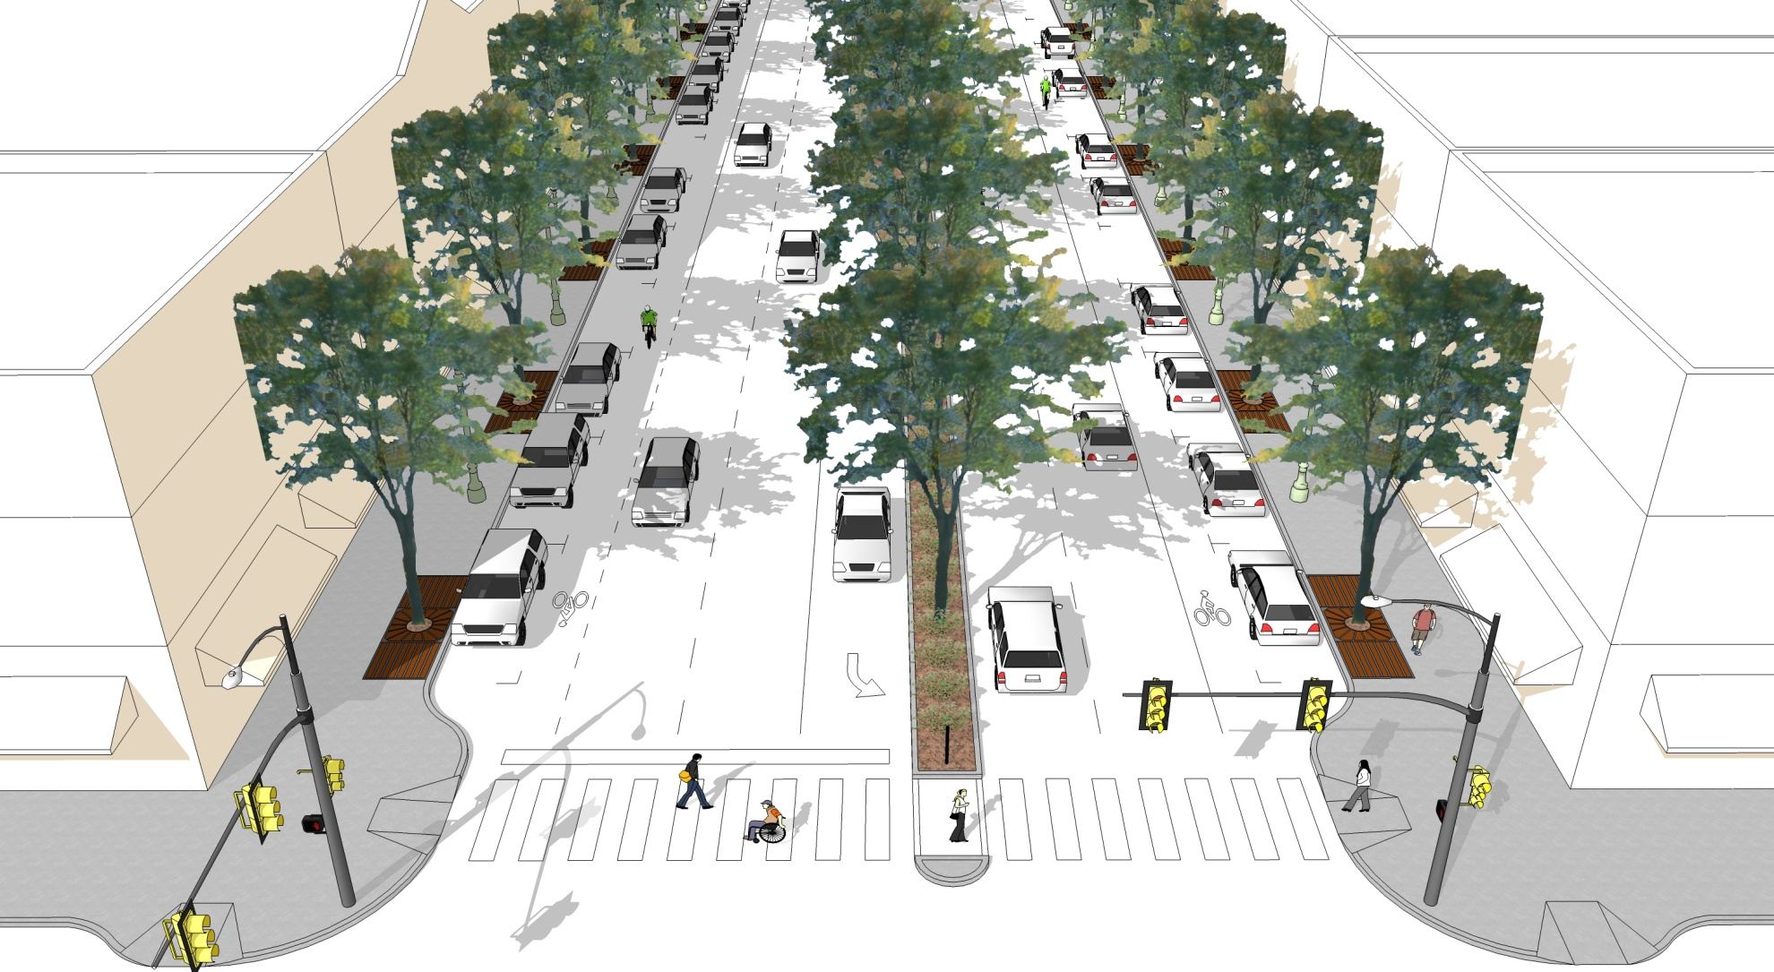
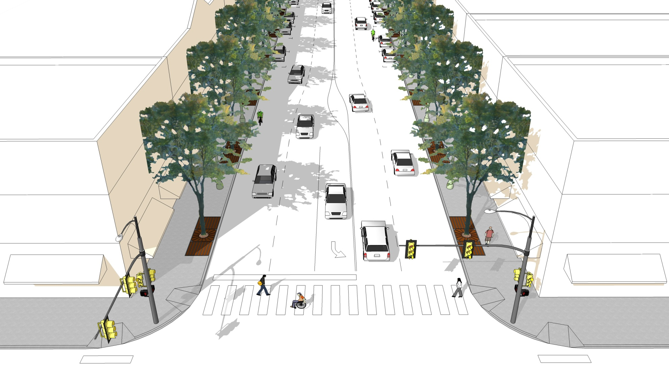
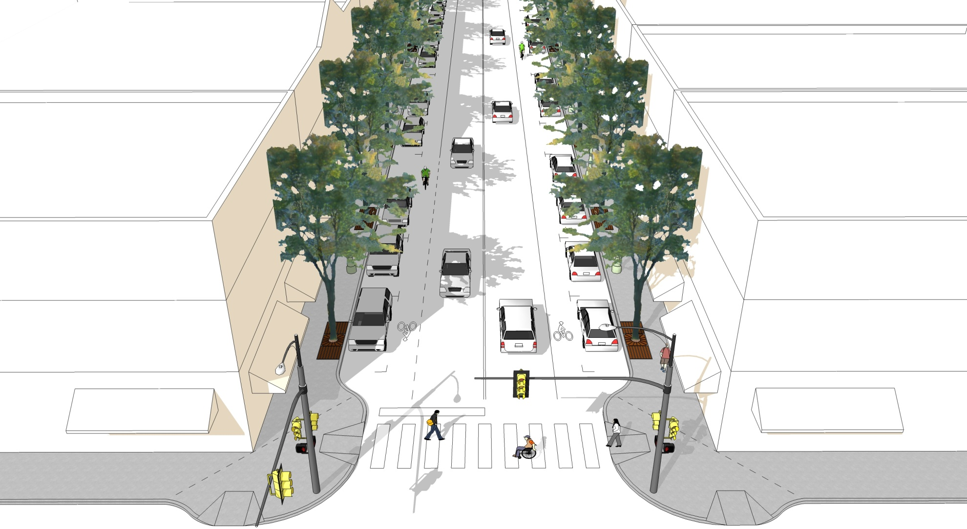
Thoroughfare Types
Three roadway classifications:
  Boulevard
  Avenue
  Street
Basis for:
  Physical configuration
  Design criteria
Boulevard
Avenue
Street

Slide 24
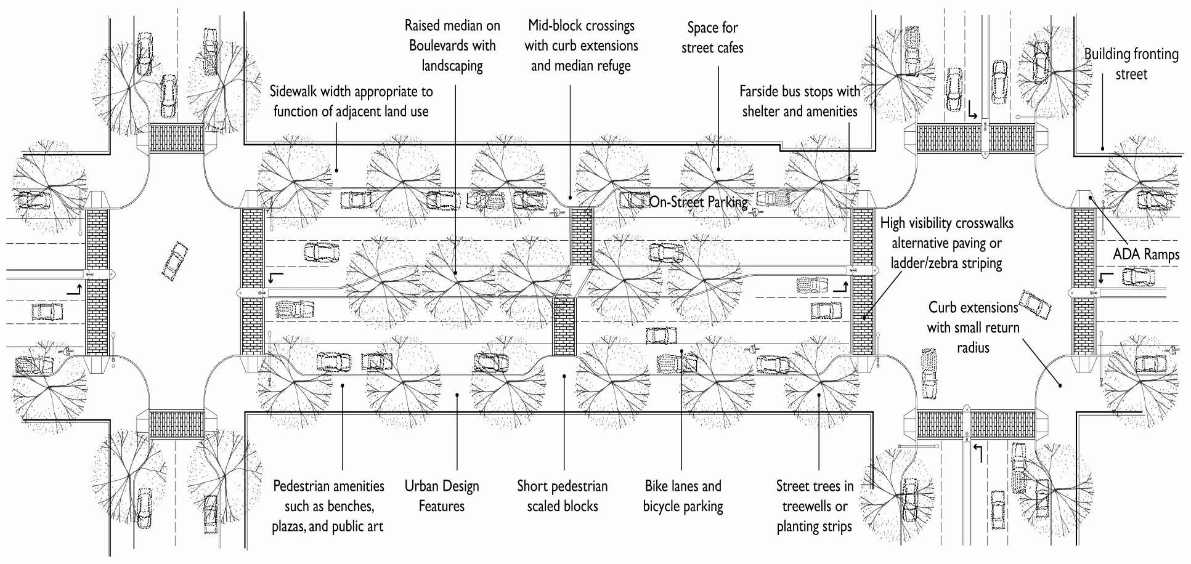
Thoroughfare Type in Design
Design criteria
  Target speed (desirable operating speed)
Physical configuration
  With surrounding context
Dimensions for:
  Streetside
  Traveled way
  Intersections

Slide 25
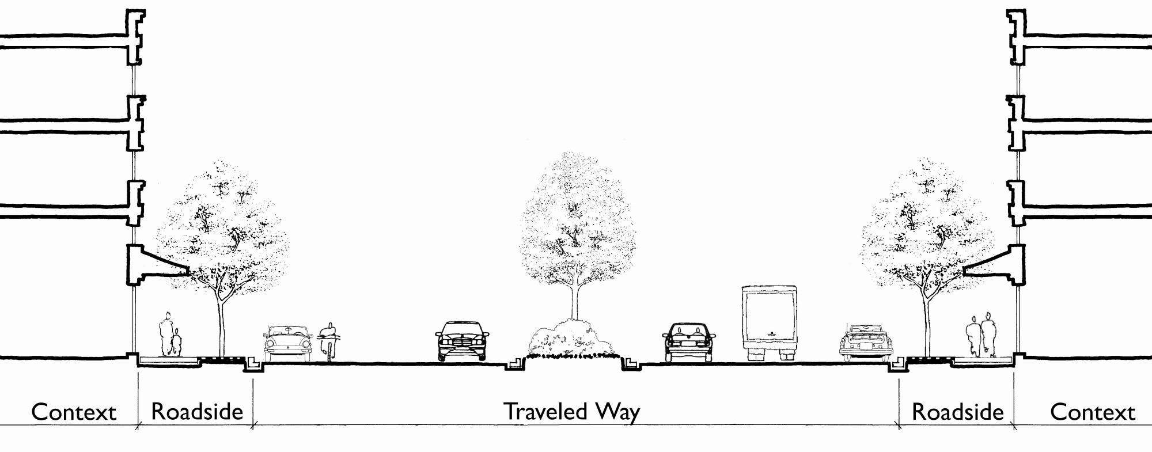
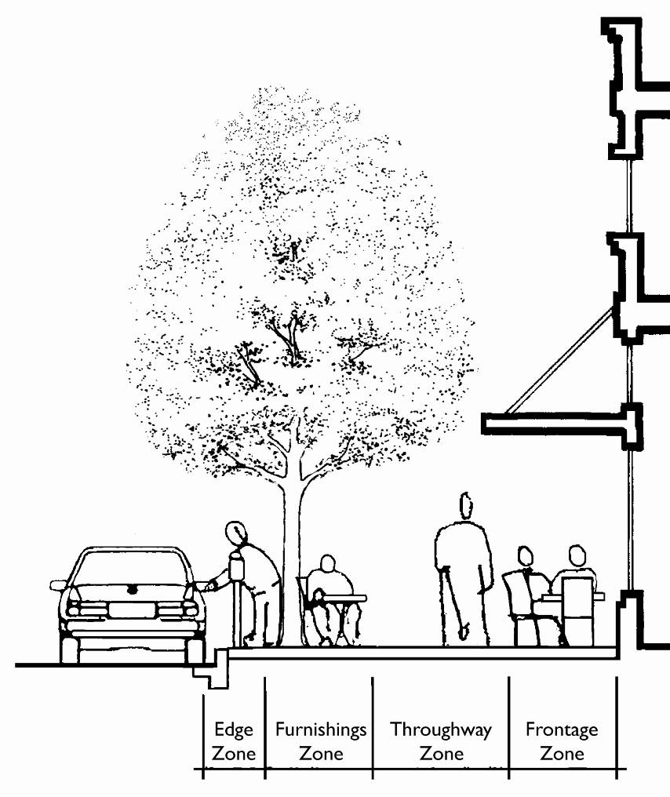
Thoroughfare Components
-
Streetside
Streetside

Slide 26
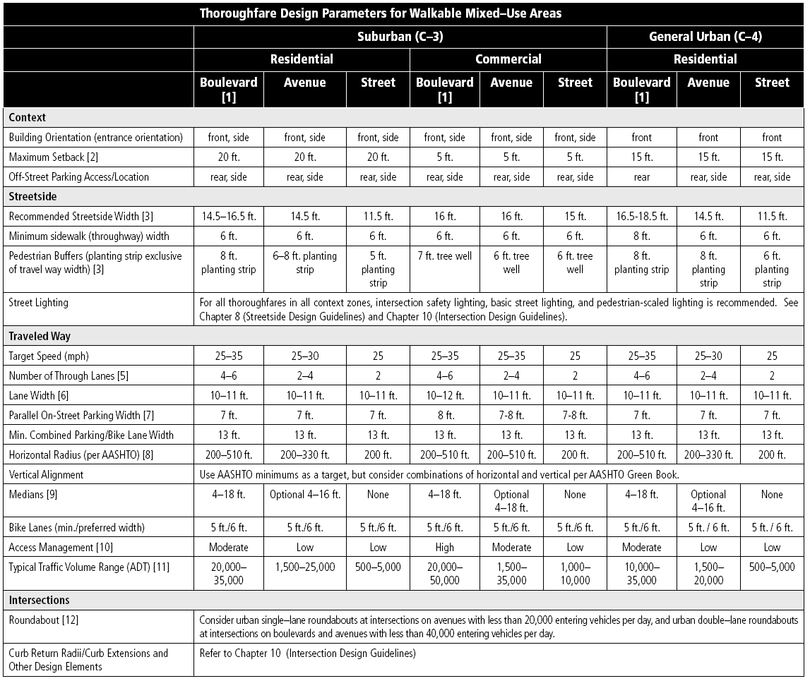
Walkable Thoroughfare Design Parameters
Starting Points

Slide 27
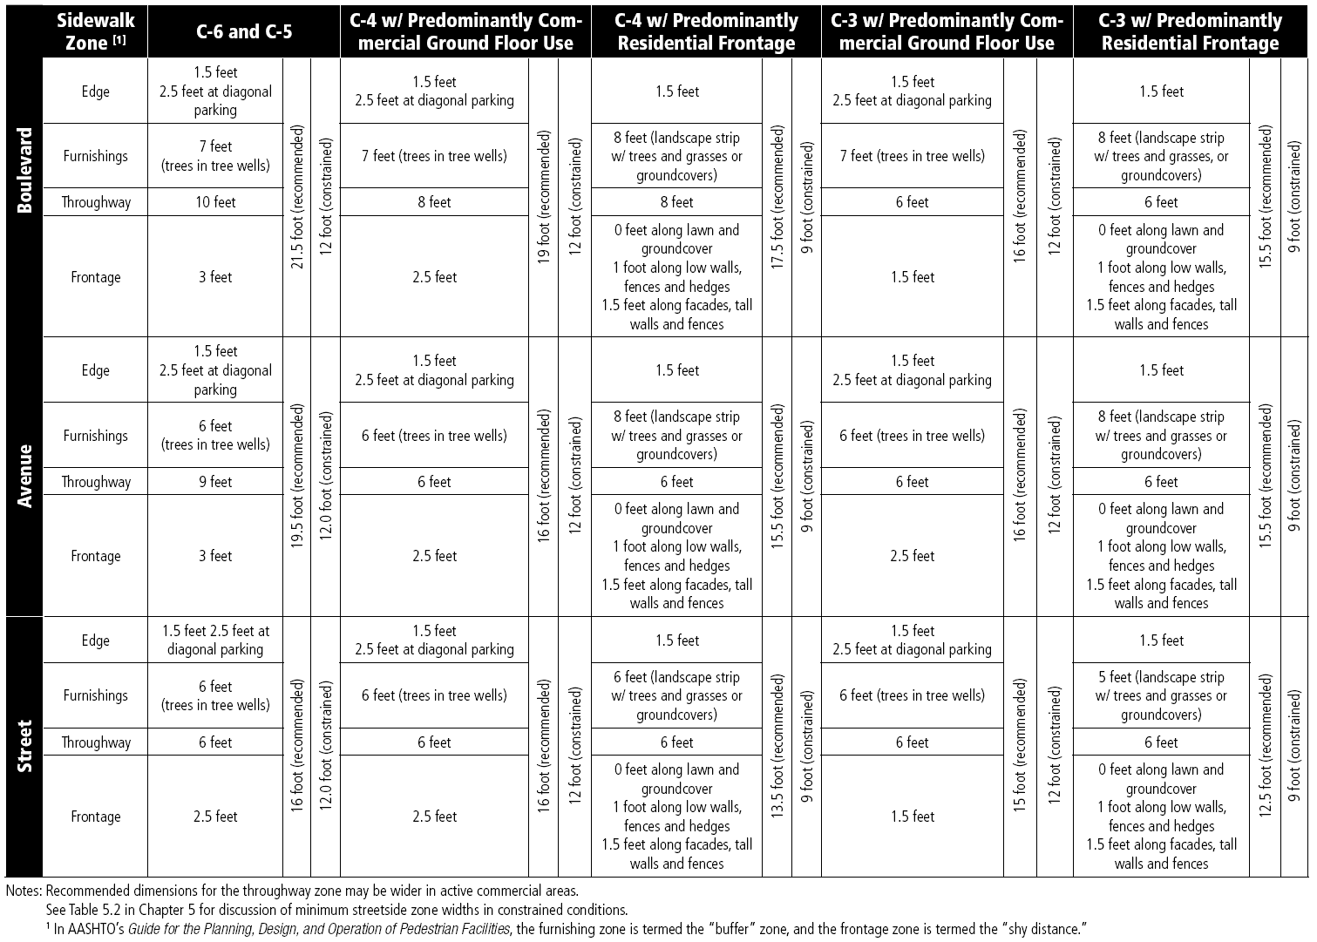
Streetside Design Criteria
Starting Points

Slide 28
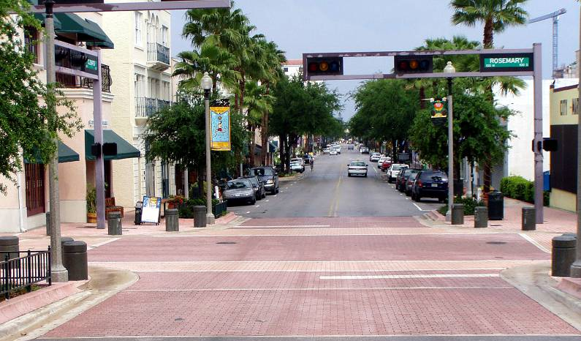
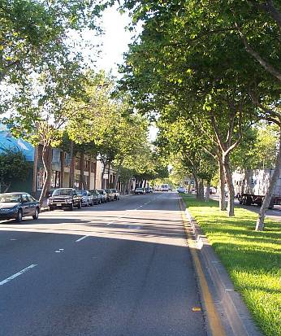
Key Differences From Conventional Approach
Start with area objectives
  Yours
  Stakeholders
Consider
  Context
  Land use
  Activity
  Thoroughfare function
  Thoroughfare type
Continue to consider comprehensive objectives
Remember - Flexibility

Slide 29
I-30/I-35W Interchange Reconstruction
Example
Downtown Ft. Worth

Slide 30
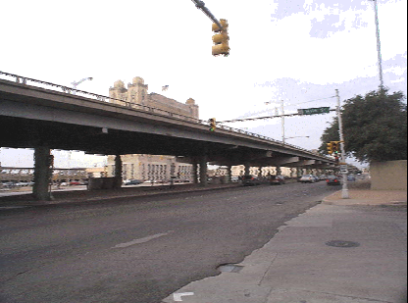
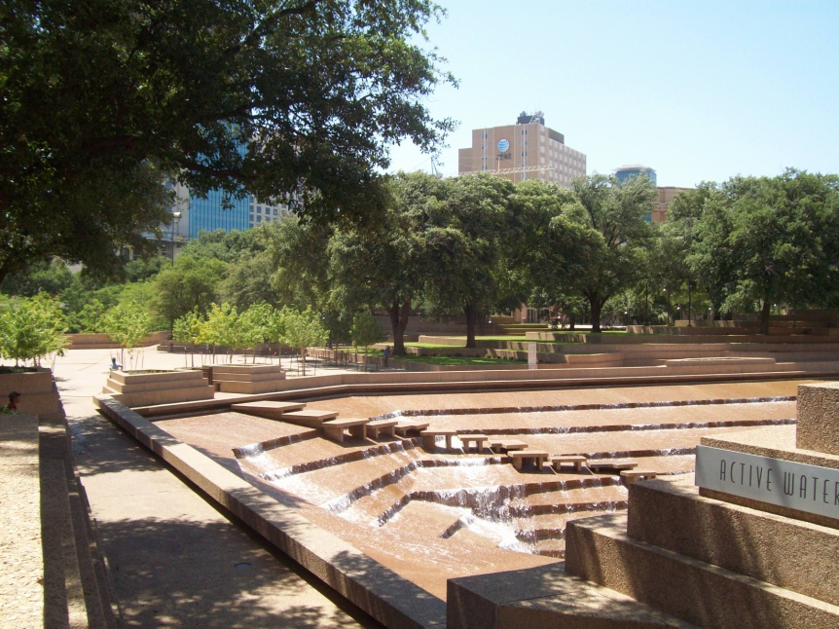
Project
Existing elevated freeway over Lancaster Avenue
Project
  Reconstruction
  Capacity and safety improvements

Slide 31
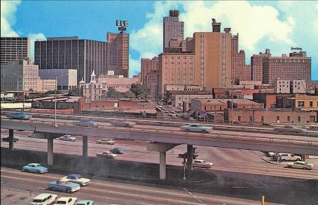
Initial Plan
Initial plan – west leg
  Widened elevated structure
Community reaction
  Opposition
  Lawsuit
  Leadership interest to find better solution

Slide 32
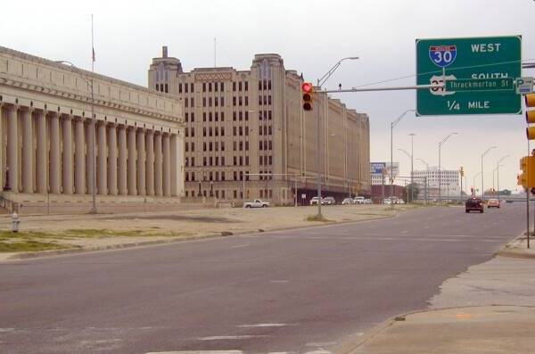
CSS Approach – Stakeholder Objectives
Objectives/concerns
  Replace aging structure
  Increase interchange capacity
  Increase safety
    Merges, weaves
    Design speed
    Sight distances
  Improve aesthetics
    Freeway
    Barrier
  Historic preservation
  Permit T&P building revitalization
  Redevelopment

Slide 33
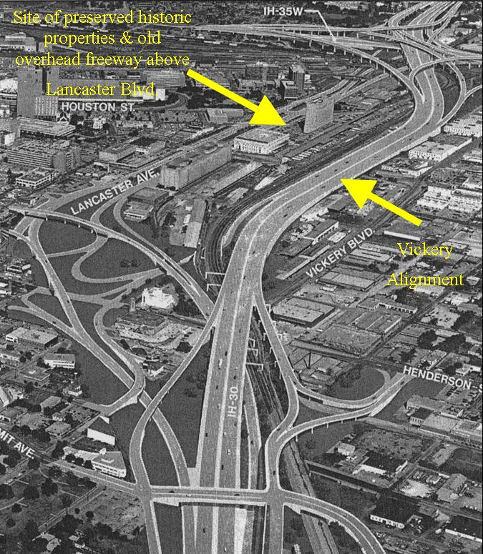
Approach
Initial alternatives
Existing alignment
  Elevated
  At-grade
  Depressed
New alignments
Visualization of preferred alternative (SDH&PT, FHWA, 1991)

Slide 34
Relocated I-30 West Leg

Slide 35
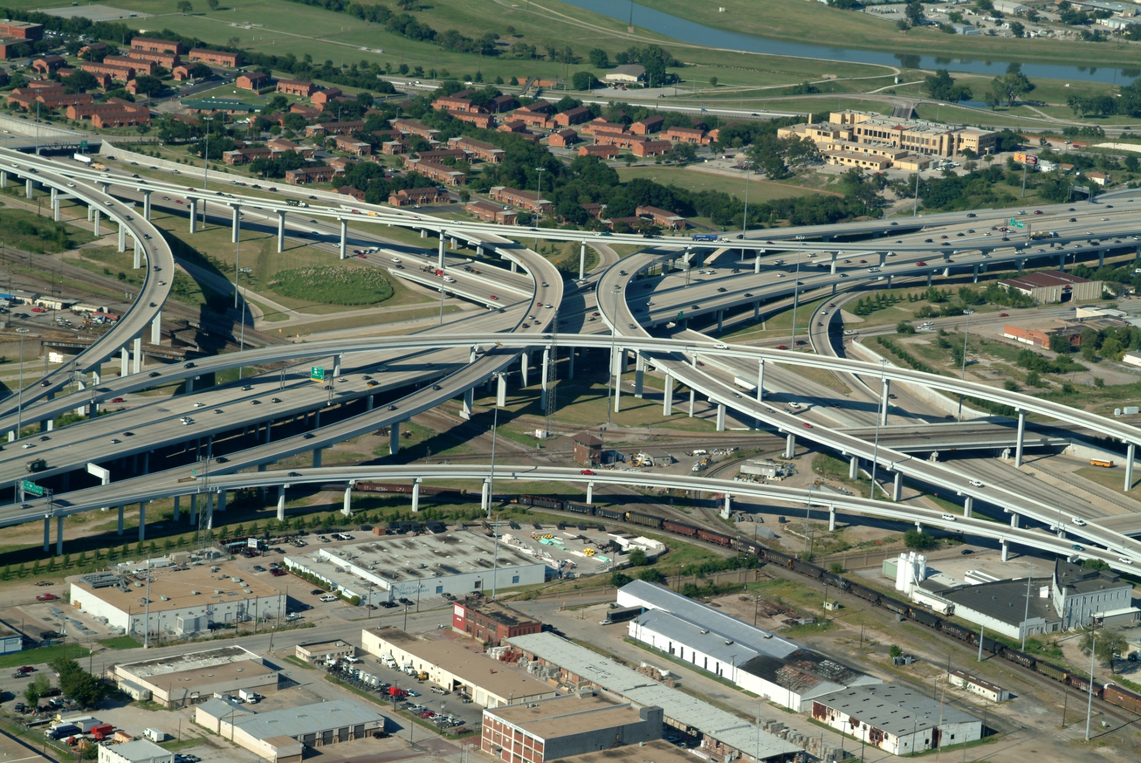
Improved Ramps

Slide 36
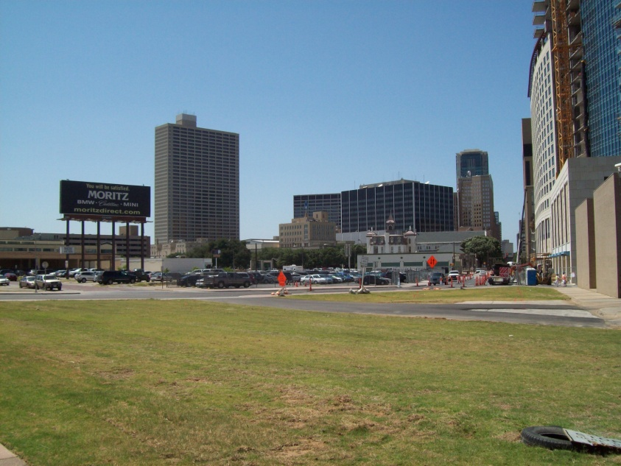
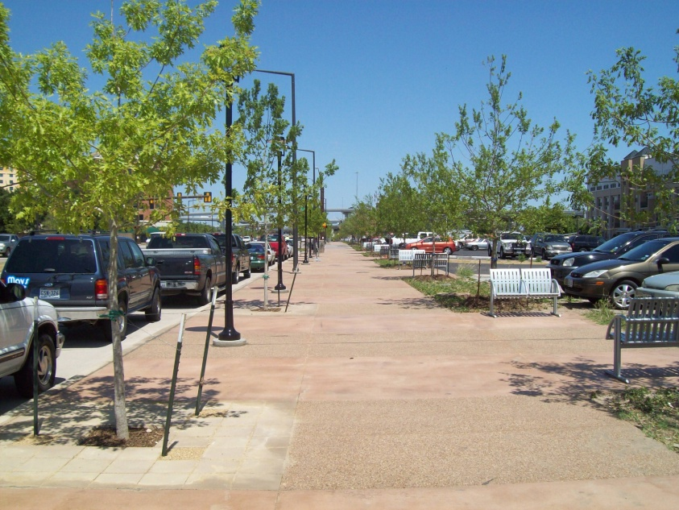
Lancaster Avenue

Slide 37
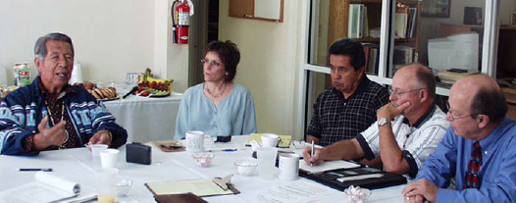
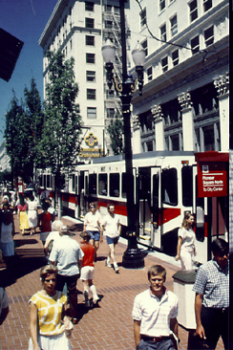
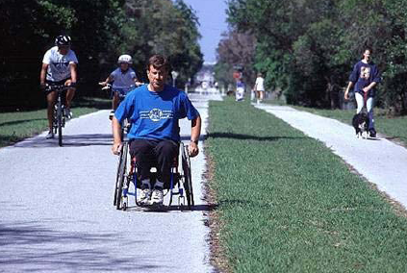
Discussion

Slide 38
For Additional Information
Brian Bochner
Texas Transportation Institute
(979) 458-3516
b-bochner@tamu.edu

